Slide 1
Software Engineering
Lecture 02
Software Process Model

Slide 2
Software process model
Process models prescribe a distinct set of activities, actions, tasks, milestones, and work products required to engineer high quality software.
Process models are not perfect, but provide roadmap for software engineering work.
Software models provide stability, control, and organization to a process that if not managed can easily get out of control
Software process models are adapted to meet the needs of software engineers and managers for a specific project.

Slide 3
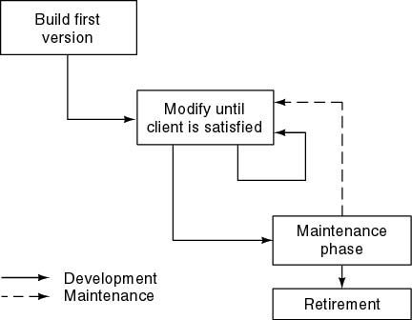
Build and Fix Model

Slide 4
Build and Fix Model
The earlier approach
Product is constructed without specification or any attempt at design.
developers simply build a product that is reworked as many times as necessary to satisfy the client.
model may work for small projects but is totally unsatisfactory for products of any reasonable size.
Maintenance is high.
Source of difficulties and deficiencies
  impossible to predict
  impossible to manage

Slide 5
Why Models are needed?
Symptoms of inadequacy: the software crisis
  scheduled time and cost exceeded
  user expectations not met
  poor quality

Slide 6
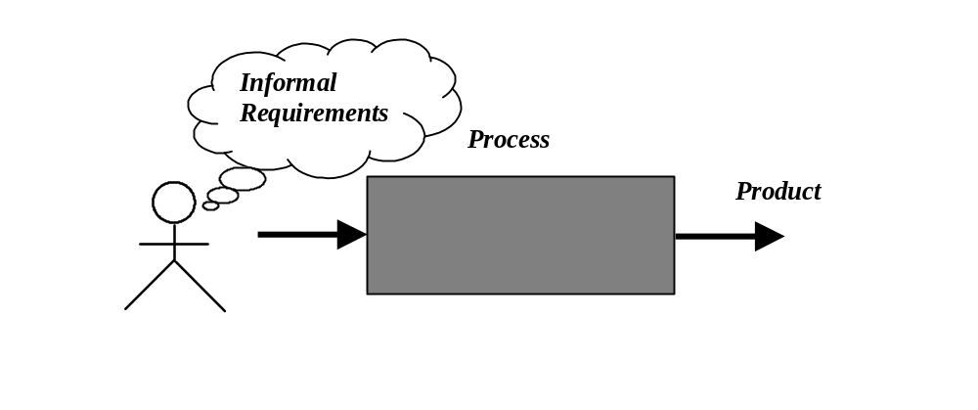
Process as a "black box"
Quality?
Uncertain /
Incomplete requirement
In the beginning

Slide 7
Problems
The assumption is that requirements can be fully understood prior to development
Interaction with the customer occurs only at the beginning (requirements) and end (after delivery)
Unfortunately the assumption almost never holds

Slide 8
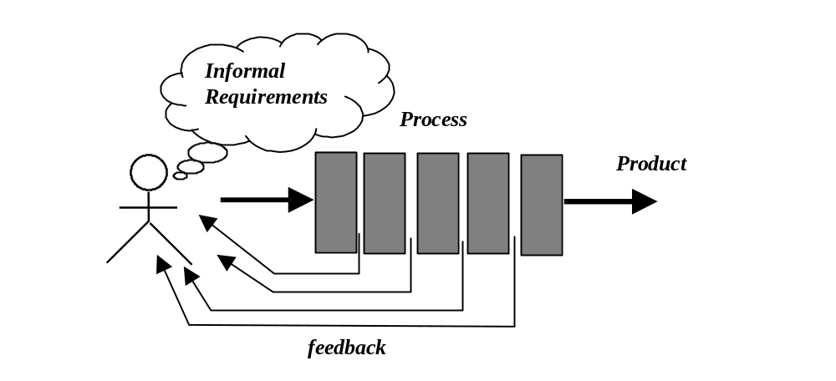
Process as a "white box"

Slide 9
Advantages
Reduce risks by improving visibility
Allow project changes as the project progresses
  based on feedback from the customer

Slide 10
Prescriptive Model
Prescriptive process models advocate an orderly approach to software engineering
  Organize framework activities in a certain order
Process framework activity with set of software engineering actions.
Each action in terms of a task set that identifies the work to be accomplished to meet the goals.
The resultant process model should be adapted to accommodate the nature of the specific project, people doing the work, and the work environment.
Software engineer choose process framework that includes activities like;
  Communication
  Planning
  Modeling
  Construction
  Deployment

Slide 11
Prescriptive Model
Calling this model as “Prescribe” because it recommend a set of process elements, activities, action task, work product & quality.
Each elements are inter related to one another (called workflow).

Slide 12
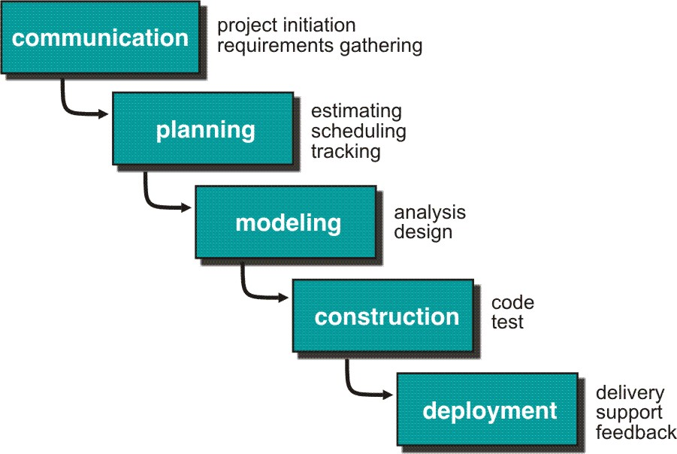
Waterfall Model or Classic Life Cycle

Slide 13
Waterfall Model or Classic Life Cycle
Requirement Analysis and Definition: What - The systems services, constraints and goals are defined by customers with system users.
Scheduling tracking -
  Assessing progress against the project plan.
  Require action to maintain schedule.
System and Software Design: How –It establishes and overall system architecture. Software design involves fundamental system abstractions and their relationships.
Integration and system testing: The individual program unit or programs are integrated and tested as a complete system to ensure that the software requirements have been met. After testing, the software system is delivered to the customer.
Operation and Maintenance: Normally this is the longest phase of the software life cycle. The system is installed and put into practical use. Maintenance involves correcting errors which were not discovered in earlier stages of the life-cycle.

Slide 14
Limitations of the waterfall model
The nature of the requirements will not change very much During development; during evolution
The model implies that you should attempt to complete a given stage before moving on to the next stage
  Does not account for the fact that requirements constantly change.
  It also means that customers can not use anything until the entire system is complete.
The model implies that once the product is finished, everything else is maintenance.
Surprises at the end are very expensive
Some teams sit ideal for other teams to finish
Therefore, this model is only appropriate when the requirements are well-understood and changes will be fairly limited during the design process.
Problems:
Real projects are rarely follow the sequential model.
Difficult for the customer to state all the requirement explicitly.
Assumes patience from customer - working version of program will not available until programs not getting change fully.

Slide 15
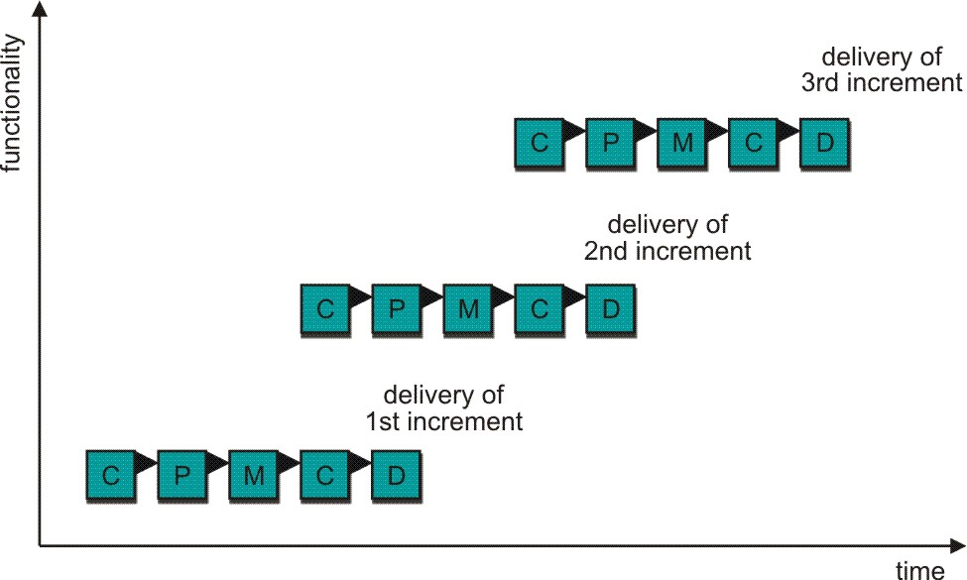
Incremental Process Model
C- Communication
P - Planning
M – Modeling
C - Construction
D - Deployment
Delivers software in small but usable pieces, each piece builds on pieces already delivered

Slide 16
The Incremental Model
Rather than deliver the system as a single delivery, the development and delivery is broken down into increments with each increment delivering part of the required functionality.
First Increment is often core product
  Includes basic requirement
  Many supplementary features (known & unknown) remain undelivered
A plan of next increment is prepared
  Modifications of the first increment
  Additional features of the first increment
It is particularly useful when enough staffing is not available for the whole project
Increment can be planned to manage technical risks.
Incremental model focus more on delivery of operation product with each increment.

Slide 17
The Incremental Model
User requirements are prioritised and the highest priority requirements are included in early increments.
Once the development of an increment is started, the requirements are frozen though requirements for later increments can continue to evolve.
Customer value can be delivered with each increment so system functionality is available earlier.
Early increments act as a prototype to help elicit requirements for later increments.
Lower risk of overall project failure.
The highest priority system services tend to receive the most testing.

Slide 18
Rational Unified Process
Rational Unified Process, or RUP, is a configurable software development process platform that delivers practices and a configurable architecture
RUP is a method of managing OO Software Development
Enables the developers to select and deploy only the process components they need for each stage of their project

Slide 19
Rational Unified Process
It can be viewed as a Software Development Framework which is extensible and features:
  Iterative Development
  Requirements Management
  Component-Based Architectural Vision
  Visual Modeling of Systems
  Quality Management
  Change Control Management

Slide 20

Team-Unifying Approach
The RUP unifies a software team by providing a common view of the development process and a shared vision of a common goal
Increased Team Productivity
  knowledge base of all processes
  view of how to develop software
  modeling language
  Rational provides many tools
Tool
Specialist
Architect
Release
Engineer
Project
Management
Analyst
Designer /
Developer
Tester
Notes:
The RUP offers:
A Team-Unifying Approach
The Rational Unified Process unifies the entire software development team and enhances team communication by providing each team member with one knowledge base, one modeling language and one view of how to develop software.
Everybody is involved; their roles and activities are well documented and are publishable over an intranet…
Re-iterate the HHGTTG and the Tower of Babel...

Slide 21
Rational Unified Process (RUP)
Phases
Process Workflows
Inception
Elaboration
Construction
Transition
Business Modeling
Requirements
Analysis & Design
Implementation
Test
Deployment
Supporting Workflows
Configuration & Change Mgmt
Project Management
Environment
Preliminary
Iteration(s)
Iter.
#1
Iter.
#2
Iter.
#n
Iter.
#n+1
Iter.
#n+2
Iter.
#m
Iter.
#m+1
Iterations
Notes:
Inception Defines the scope of the project. A business plan is often created to determine whether resources should be committed or not. The model is 20% complete.
Elaboration Plan project, specify features, baseline architecture. Requirements are firmed up, we’re now 80% complete. A detailed cost/resource estimation can be drawn up.
Construction Build the product. Several iterations.
Transition Move the product into and end user environment. Training, installation and support.
An iteration is a distinct sequence of activities based on an established plan and evaluation criteria, resulting in an executable release (internal or external)
A workflow shows all the activities you might go through to produce a particular set of artifacts – more later.

Slide 22
Phases in RUP
Major
Milestones
Inception
Elaboration
Construction
Transition
time
The Rational Unified Process has four phases:
  Inception - Define the scope of project
  Elaboration - Plan project, specify features, baseline architecture
  Construction - Build the product
  Transition - Transition the product into end user community

Slide 23
Inception phase
Establishing the project's software scope and boundary conditions, including an operational vision, acceptance criteria and what is intended to be in the product and what is not.
Discriminating the critical use cases of the system, the primary scenarios of operation that will drive the major design tradeoffs.
Exhibiting, and maybe demonstrating, at least one candidate architecture against some of the primary scenarios.
Estimating the overall cost and schedule for the entire project (and more detailed estimates for the elaboration phase that will immediately follow).
Estimating potential risks (the sources of unpredictability)
Preparing the supporting environment for the project.

Slide 24
Elaboration phase
Defining, validating and baselining the architecture as rapidly as practical.
Refining the Vision, based on new information obtained during the phase, establishing a solid understanding of the most critical use cases that drive the architectural and planning decisions.
Creating and baselining detailed iteration plans for the construction phase.
Refining the development case and putting in place the development environment, including the process, tools and automation support required to support the construction team.
Refining the architecture and selecting components. Potential components are evaluated and the make/buy/reuse decisions sufficiently understood to determine the construction phase cost and schedule with confidence. The selected architectural components are integrated and assessed against the primary scenarios.

Slide 25
Construction phase
Resource management, control and process optimization
Complete component development and testing against the defined evaluation criteria
Assessment of product releases against acceptance criteria for the vision.

Slide 26
Transition phase
Executing deployment plans.
Finalizing end-user support material.
Testing the deliverable product at the development site.
Creating a product release.
Getting user feedback.
Fine-tuning the product based on feedback.
Making the product available to end users.

Slide 27
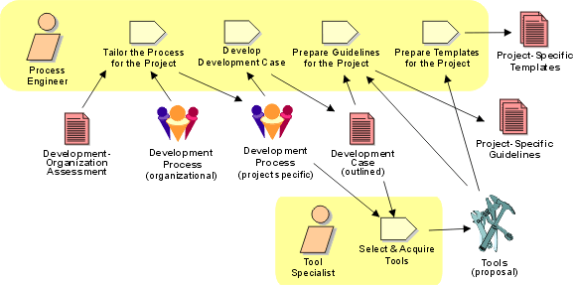
Workflow Detail: Prepare Environment for Project

Slide 28
Workflows - 3 key elements
Three key elements of each workflows:
  Artifacts
  Roles
  Activities

Slide 29
Artifacts
A piece of information that:
Is produced, modified, or used by a process
Defines an area of responsibility
Is subject to version control.
An artifact can be a model, a model element, or a document. A document can enclose other documents.

Slide 30
Roles
Represent a role that an individual may play on the project
Responsible for producing artifacts
Distinct from actors

Slide 31
Activities
Tasks performed by people representing particular roles in order to produce artifacts

Slide 32
Brief summary of process workflows
  Business Modelling
  Requirements
  Analysis & Design
  Implementation
  Test
  Deployment

Slide 33
Business Modelling
Understand structure & dynamics of organization in which system is to be deployed
Understand current problems in the target organization & identify improvement potential
Ensure customers, end users & developers have common understanding of target organisation
Derive system requirements to support target organisation

Slide 34
Analysis & Design
Transform requirements into a design of the system
Evolve a robust architecture for the system
Adapt design to match the implementation environment, designing it for performance

Slide 35
Implementation
Define organization of the code, in terms of implementation subsystems organized in layers
Implement classes & objects in terms of components
Test developed components as units
Integrate results into an executable system

Slide 36
Test
Verify interaction between objects
Verify proper integration of all components of the software
Verify that all requirements have been correctly implemented
Identify & ensure defects are addressed prior to deployment

Slide 37
Deployment
Provide custom installation
Provide shrink wrap product offering
Provide software over internet

Slide 38
Brief summary of supporting workflows
  Configuration & Change Management
  Project Management
  Environment

Slide 39
Configuration & Change Management
Supports development methods
Maintains product integrity
Ensures completeness & correctness of configured product
Provides stable environment within which to develop product
Restricts changes to artifacts based on project policies
Provides an audit trail on why, when & by whom any artifact was changed

Slide 40
Project Management
A framework for managing software-intensive projects
Practical guidelines for planning, staffing, executing & monitoring projects
A framework for managing risk

Slide 41
Environment
Design, implement and manage the project’s required technical environments
Define the technical architectures for the development, system validation, testing & staging/release management environments
When possible, standard architectural models for given types of platforms should be utilized when defining the production environment

Slide 42

Bringing It All Together...
In an iteration, you walk through all workflows
Phases
Process Workflows
Inception
Elaboration
Construction
Transition
Business Modeling
Requirements
Analysis & Design
Implementation
Test
Deployment
Supporting Workflows
Configuration & Change Mgmt
Project Management
Environment
Preliminary
Iteration(s)
Iter.
#1
Iter.
#2
Iter.
#n
Iter.
#n+1
Iter.
#n+2
Iter.
#m
Iter.
#m+1
Iterations

Slide 43
Evolutionary Process Model
Produce an increasingly more complete version of the software with each iteration.
Evolutionary Models are iterative.
Evolutionary models are:
  Prototyping
  Spiral Model
  Concurrent Development Model
  Fourth Generation Techniques (4GT)

Slide 44
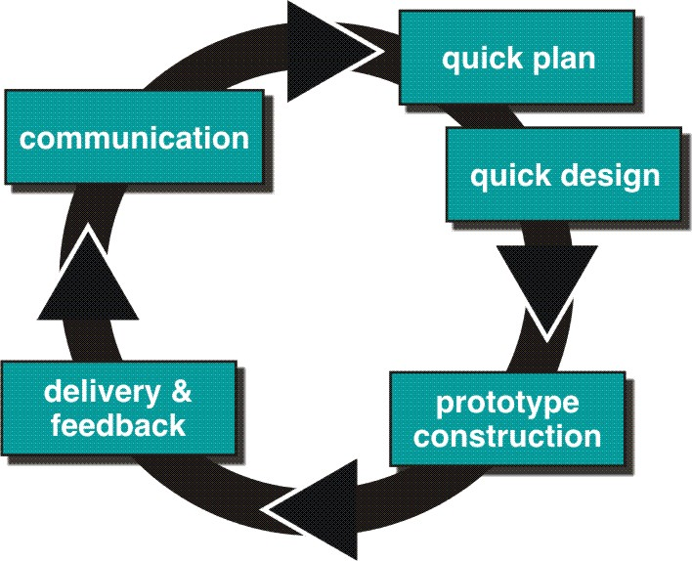
Evolutionary Process Models : Prototyping

Slide 45
Prototyping cohesive
Best approach when:
  Objectives defines by customer are general but does not have details like input, processing, or output requirement.
  Developer may be unsure of the efficiency of an algorithm, O.S., or the form that human machine interaction should take.
It can be used as standalone process model.
Model assist software engineer and customer to better understand what is to be built when requirement are fuzzy.
Prototyping start with communication, between a customer and software engineer to define overall objective, identify requirements and make a boundary.
Going ahead, planned quickly and modeling (software layout visible to the customers/end-user) occurs.
Quick design leads to prototype construction.
Prototype is deployed and evaluated by the customer/user.
Feedback from customer/end user will refine requirement and that is how iteration occurs during prototype to satisfy the needs of the customer.

Slide 46
Prototyping (cont..)
Prototype can be serve as “the first system”.
Both customers and developers like the prototyping paradigm.
  Customer/End user gets a feel for the actual system
  Developer get to build something immediately.
Problem Areas:
Customer cries foul and demand that “a few fixes” be applied to make the prototype a working product, due to that software quality suffers as a result.
Developer often makes implementation in order to get a prototype working quickly without considering other factors in mind like OS, Programming language, etc.
Customer and developer both must be agree that the prototype is built to serve as a mechanism for defining requirement.

Slide 47
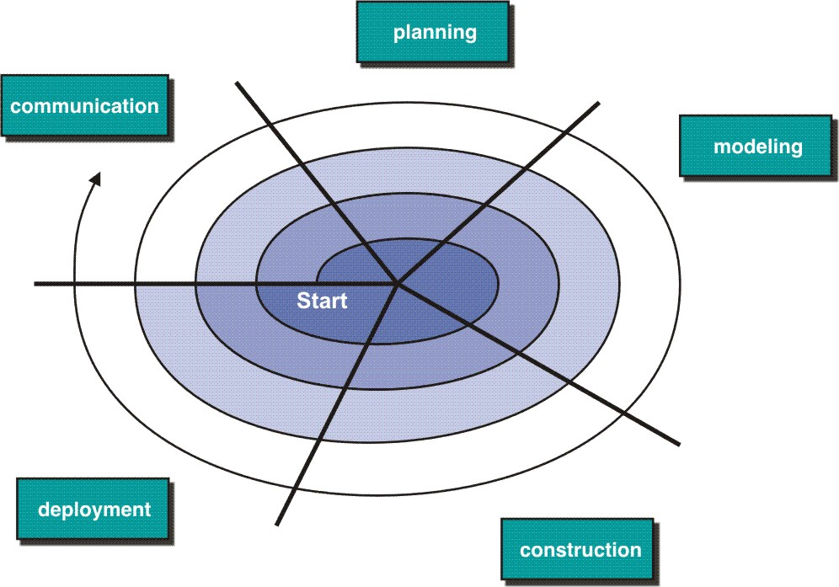
Evolutionary Model: Spiral Model

Slide 48
Spiral Model
Couples iterative nature of prototyping with the controlled and systematic aspects of the linear sequential model
It provide potential for rapid development of increasingly more complete version of the software.
Using spiral, software developed in as series of evolutionary release.
  Early iteration, release might be on paper or prototype.
  Later iteration, more complete version of software.
Divided into framework activities (C,P,M,C,D). Each activity represent one segment.
Evolutionary process begins in a clockwise direction, beginning at the center risk.
First circuit around the spiral might result in development of a product specification. Subsequently, develop a prototype and then progressively more sophisticated version of software.
Unlike other process models that end when software is delivered.
It can be adapted to apply throughout the life of software.

Slide 49
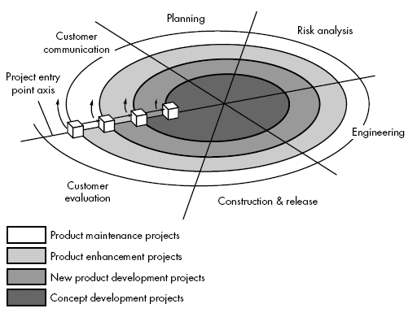
Spiral Model

Slide 50
Spiral Model (cont.)
Concept Development Project:
Start at the core and continues for multiple iterations until it is complete.
If concept is developed into an actual product, the process proceeds outward on the spiral.
New Product Development Project:
New product will evolve through a number of iterations around the spiral.
Later, a circuit around spiral might be used to represent a “Product Enhancement Project”
Product Enhancement Project:
There are times when process is dormant or software team not developing new things but change is initiated, process start at appropriate entry point.

Slide 51
Spiral models uses prototyping as a risk reduction mechanism but, more important, enables the developer to apply the prototyping approach at each stage in the evolution of the product.
It maintains the systematic stepwise approach suggested by the classic life cycle but also incorporates it into an iterative framework activity.
If risks cannot be resolved, project is immediately terminated
Problem Area:
It may be difficult to convince customers (particularly in contract situations) that the evolutionary approach is controllable.
If a major risk is not uncovered and managed, problems will undoubtedly occur.

Slide 52
Agile Process
What is “Agility”?
  Effective (rapid and adaptive) response to change
  Effective communication among all stakeholders
  Drawing the customer onto the team
  Organizing a team so that it is in control of the work performed
  Yielding …
  Rapid, incremental delivery of software

Slide 53
An Agile Process
Is driven by customer descriptions of what is required (scenarios)
Recognizes that plans are short-lived
Develops software iteratively with a heavy emphasis on construction activities
Delivers multiple ‘software increments’
Adapts as changes occur

Slide 54
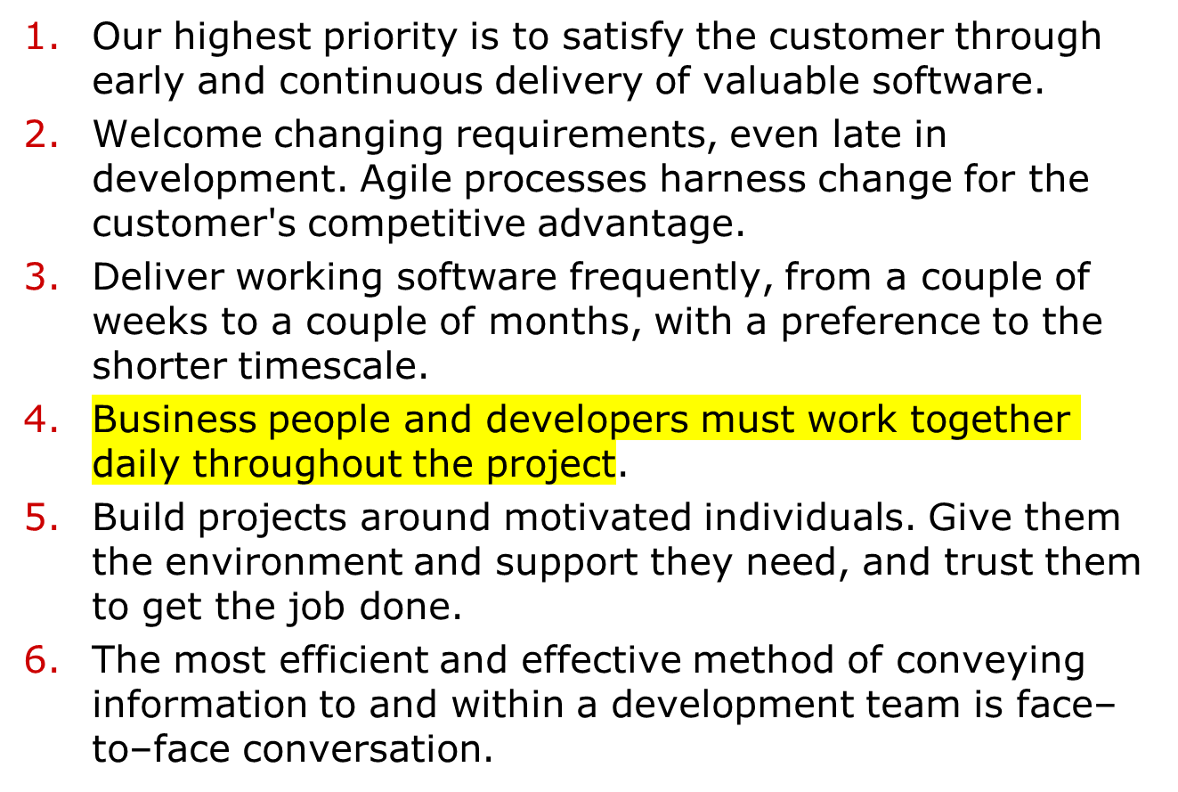
Agility Principles

Slide 55
Agility Principles (cont.)
Working software is the primary measure of progress.
Agile processes promote sustainable development. The sponsors, developers, and users should be able to maintain a constant pace indefinitely.
Continuous attention to technical excellence and good design enhances agility.
Simplicity – the art of maximizing the amount of work not done – is essential.
The best architectures, requirements, and designs emerge from self–organizing teams.
At regular intervals, the team reflects on how to become more effective, then tunes and adjusts its behavior accordingly.

Slide 56
Unified Process Model
Unified Process is component-based, which means that the software system being built is made up of software components interconnected via well-defined interfaces in UML

Slide 57


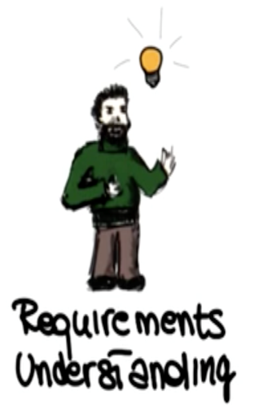
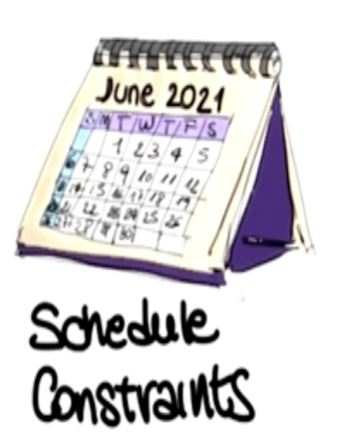
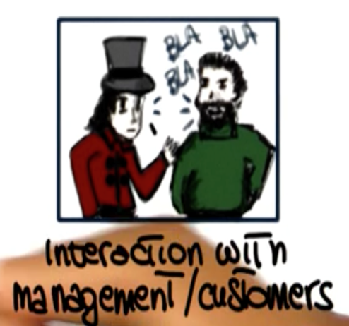

Choosing a SDLC Model
Notes:
We just saw several software process models, and there are many, many more. And because these process models define the master plan for our project, the specific process model that we choose has as much influence over a project's success as any other major planning decision that we make. Therefore, it is very important that we pickthe appropriate model for our development process. Picking an appropriatemodel can ensure the success of a project. On thecontrary, if we choose the wrong model, that can be aconstant source of problems and ultimately, it can make the projectfail. So how can we choose the right model for aproject? To be able to do so, we have to take intoconsideration many factors. In particular, we need to be aware ofwhat level of understanding we have of the requirements. Do we understandall the requirements? Are we going to be able to collect allthe requirements in advance, or collecting requirements is going to be hard andtherefore, we might want to follow a process that is more flexiblewith that respect. Another important point is the expected lifetime of theproject. Is this a quick project that we are putting together fora specific purpose or something that's going to last for for a numberof years and that we're going to maintain over all those years?That's going to make a difference in the way we decide to developthat project. Also, what is the level of risk involved? Do weknow the domain very well? Do we know exactly the technologies involved?Well, if so, we might go with a more traditional process. Otherwise,we might want to be more agile, more flexible. It is alsovery important to know the schedule constraints. How much time, how manyresources do we have for this project? What is the expected interactionwith the management and the customer? In particular for this ladder, thereare many processes that rely on the fact that there can bea continuous interaction with the customer. If that interaction is not there,there's no way we are going to be able to use these processes.Conversely, there are processes that don't require the presence of the customerat all, except for the initial phase and maybe some checking points andso if the customer is very inaccessible, we might want to followone of those processes, instead of one of the more demanding ones interms of customer's time. Finally, it is important to take into accountthe level of the expertise of the people involved. Do we have peoplethat know the technologies that we're using? Do we know people thatknow a specific kind of process?Some processes require some specific expertise andwe're not going to be able to follow that process if we don'thave the right expertise. So we need to take into account all ofthese aspects, and sometimes more, in order to be able to makethe right decision and pick the right software process model for our project.

Slide 58
Choosing a SDLC Model
Is the SDLC suitable for the size of our team and their skills?
Is the SDLC suitable for the selected technology we use for implementing the solution?
Is the SDLC suitable for client and stakeholders concerns and priorities?
Is the SDLC suitable for the geographical situation (distributed team)?
Is the SDLC suitable for the size and complexity of our software?
Is the SDLC suitable for the type of projects we do?
Is the SDLC suitable for our software engineering capability?
Is the SDLC suitable for the project risk and quality insurance?

Slide 59
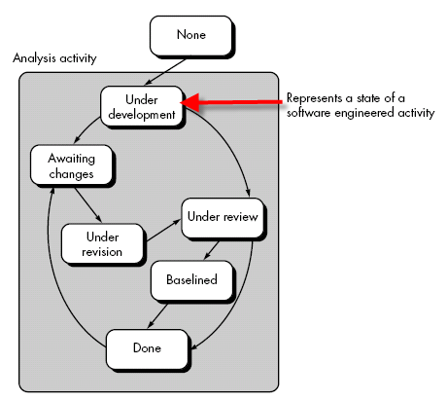
Concurrent Development Model

Slide 60
Concurrent Development Model
It represented schematically as series of major technical activities, tasks, and their associated states.
It is often more appropriate for system engineering projects where different engineering teams are involved.
The activity-modeling may be in any one of the states for a given time.
All activities exist concurrently but reside in different states.
E.g.
The analysis activity (existed in the none state while initial customer communication was completed) now makes a transition into the under development state.
Analysis activity moves from the under development state into the awaiting changes state only if customer indicates changes in requirements.
Series of event will trigger transition from state to state.
E.g. During initial stage there was inconsistency in design which was uncovered. This will triggers the analysis action from the Done state into Awaiting Changes state.

Slide 61
Concurrent Development (Cont.)
Visibility of current state of project
It define network of activities
Each activities, actions and tasks on the network exists simultaneously with other activities ,actions and tasks.
Events generated at one point in the process network trigger transitions among the states.

Slide 62
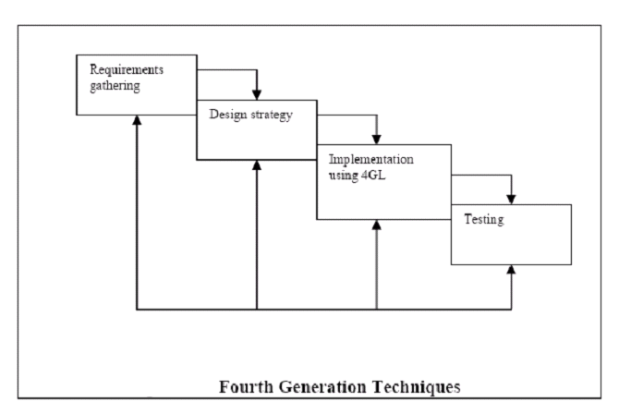
Fourth Generation Techniques(4GT)

Slide 63
4GT
Like all other models, 4GT begins with a requirements gathering phase.
Ideally, the customer would describe the requirements, which are directly translated into an operational prototype.
Practically, however, the client may be unsure of the requirements, may be ambiguous in his specs or may be unable to specify information in a manner that a 4GT tool can use.
For small applications, it may be possible to move directly from the requirements gathering phase to the implementation phase using a nonprocedural fourth generation language.
However for larger projects a design strategy is necessary. Otherwise, the same difficulties are likely to arise as with conventional approaches.

Slide 64
4GT
To transform a 4GT implementation into a product, the developer must conduct thorough testing, develop meaningful documentation.
In addition, the 4GT developed software must be built in a manner that enables maintenance to be performed quickly.
Merits:
Dramatic reduction in software development time. (For small and intermediate application)
Improved productivity for software developers.
Demerits:
Not much easier to use as compared to programming languages
The maintainability of large software systems built using 4GT is open to question.

Slide 65
4GT
4GT Software tool is used to generate the source code for a software system from a high level specification representation
Commonly used 4GT in development models are mentioned below:
  Report Generation
  Data base query language
  Data Manipulation
  Screen definition and interaction
  Code Generation
  Web engineering Tools
  high-level graphics

Slide 66
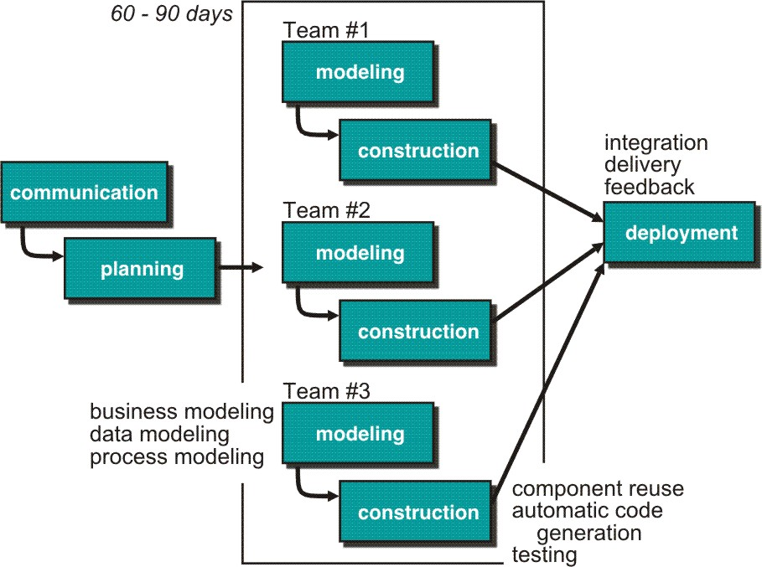
Rapid Application Development (RAD) Model
Makes heavy use of reusable software components with an extremely short development cycle

Slide 67
RAD model
Communication – to understand business problem.
Planning – multiple s/w teams works in parallel on diff. system.
Modeling –
  Business modeling – Information flow among business is working.
  Ex. What kind of information drives?
  Who is going to generate information?
  From where information comes and goes?
  Data modeling – Information refine into set of data objects that are needed to support business.
  Process modeling – Data object transforms to information flow necessary to implement business.

Slide 68
Construction – it highlighting the use of pre-existing software component.
Deployment – Deliver to customer basis for subsequent iteration.
RAD model emphasize a short development cycle.
“High speed” edition of linear sequential model.
If requirement are well understood and project scope is constrained then it enable development team to create “ fully functional system” within a very short time period.

Slide 69
RAD Model
If application is modularized (“Scalable Scope”), each major function to be completed in less than three months.
Each major function can be addressed by a separate team and then integrated to form a whole.
Drawback:
For large but scalable projects
  RAD requires sufficient human resources
Projects fail if developers and customers are not committed in a much shortened time-frame
Problematic if system can not be modularized
Not appropriate when technical risks are high ( heavy use of new technology)

Slide 70
Component Based Development
component-based development (CBD) model incorporates many of the characteristics of the spiral model.
It is evolutionary by nature and iterative approach to create software.
CBD model creates applications from prepackaged software components (called classes).

Slide 71
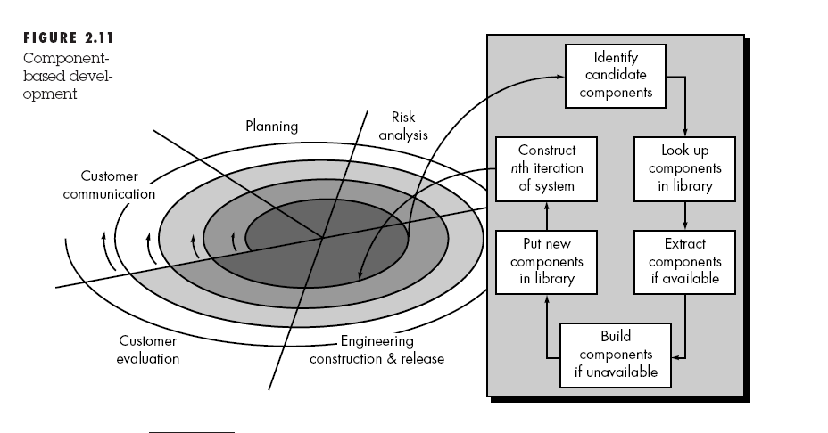

CBD Model

Slide 72
CBD model (cont.)
Modeling and construction activities begin with identification of candidate components.
Classes created in past software engineering projects are stored in a class library or repository.
Once candidate classes are identified, the class library is searched to determine if these classes already exist.
If class is already available in library extract and reuse it.
If class is not available in library, it is engineered or developed using object-oriented methods.
Any new classes built to meet the unique needs of the application.
Now process flow return to the spiral activity.

Slide 73
CBD model (cont.)
CBD model leads to software reusability.
Based on studies, CBD model leads to 70 % reduction in development cycle time.
84% reduction in project cost.
Productivity is very high.

